Slide 1
Tõlkes kaduma läinud
Kristiina Isand-Savinski
Rakvere valla haridus- ja noorsootöökonverents
24. august 2021

Slide 2
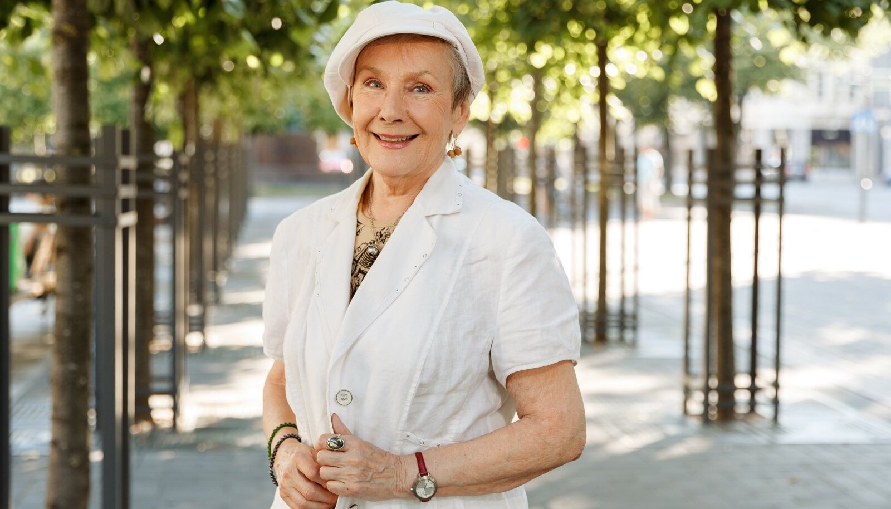

Slide 3


Slide 4

Plahvatus

Slide 5


Slide 6
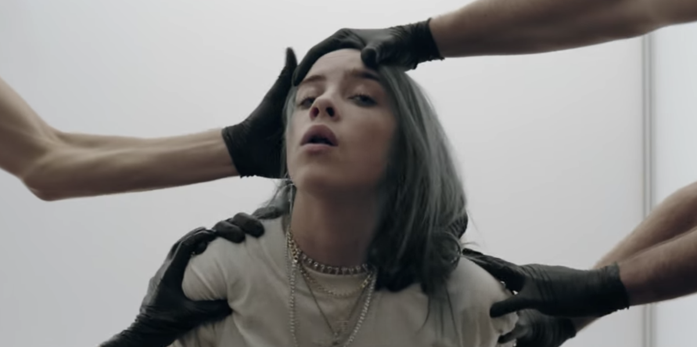
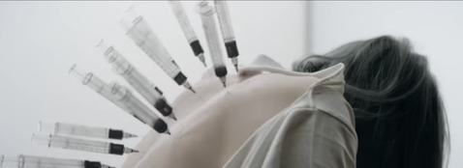
What do you want from me?
Why don't you run from me?
What are you wondering?
What do you know?
Why aren't you scared of me?
Why do you care for me?
When we all fall asleep, where do we go?
For the debt I owe, gotta sell my soul
'Cause I can't say no, no, I can't say no
Then my limbs all froze and my eyes won't close
And I can't say no, I can't say no

Slide 7
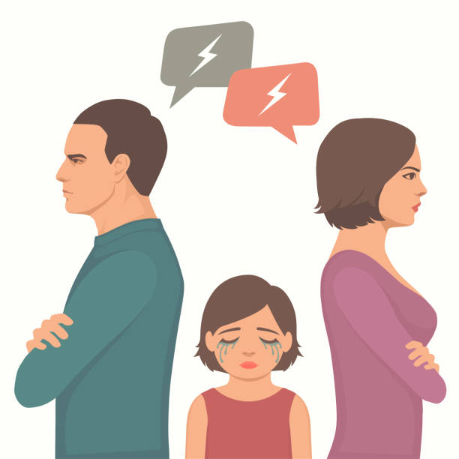
Konfliktid ja peresuhted

Slide 8
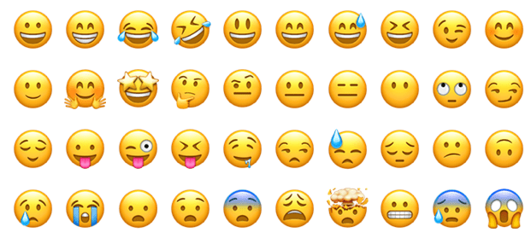
Töö emotsioonidega

Slide 9
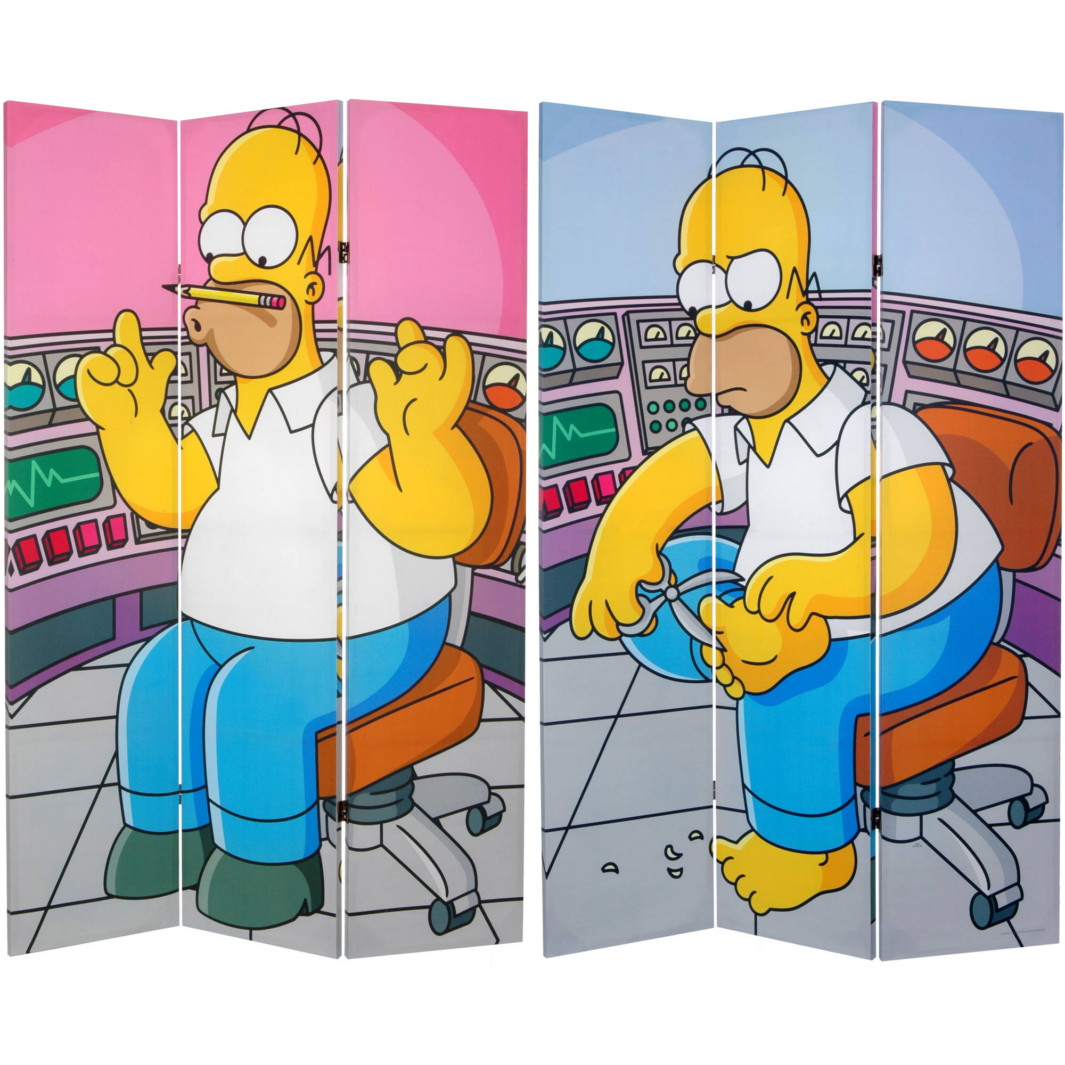
Praktiline harjutus

Slide 10

Tasakaal

Slide 11
Aitäh kuulamast!
© Kasvamine Iseendaks OÜ

